Slide 1
Termination Discrepancy Fix Automation
Sep 19, 2024

Slide 2
Agenda
Discrepancy Analysis and it’s importance
Problem Statement and outcome
Observation
Existing Process of discrepancy fix (Manual approach)
Automation Possibilities
Automation Approach
Flow Diagram
Business Advantage

Slide 3
Discrepancy Analysis and it’s importance
Every System needs a regular discrepancy analysis process
Number of different vendor products are integrated, and it is very important to validate their collaboration.
No matter an organization keep it for always or for specific duration until system gets stable and stream-lined.
This analysis process can be manual or automated depends on complexity, effort, and time.
Discrepancy analysis is a pro-active action to identify and resolve the issue

Slide 4
Problem Statement and outcome
Terminated users are skipped/delayed from getting processed in SailPoint
Creates the discrepancy between source and target applications.
Users are still able to access the internal applications for longer period of time.
High number of incidents raised by customers.
Sample Example inc | Discrepancy Category
INC11856655 | BoD Accounts with null job code
INC11903823 | New Mexico users being created in SAP
INC11858441 | Reevaluate Entitlements
INC11853751 | Rehires/Terms Not Synced
INC11860832 | Reprocess Breeze Accounts
INC11828412 | User Data in OIG/AD Not Matching Workday(Manager, jobcode, location)
INC11896388 | Remove Role from User

Slide 5
Observation
Following or parent task is taking longer than expected time 1.1
Past dated termination. Appendix 1.2
Long running Fargate instance cause aggregation task get halted.
SailPoint Connector Exception. Appendix 1.2
High number discrepant users

Slide 6
Existing Process of Discrepancy fix (manual approach)
Our team manually doing termination discrepancy fix everyday after the scheduled “Workday Delta Aggregation” task at pm IST.
Retrieve the terminated users from both SailPoint and Workday in either of these 2 steps.
List of terminated users shared by Workday team at 6pm CST.
Users with effective end date as sysdate from SailPoint.
*** Note: 2nd option is taking if and only if the Workday update don’t come and it happens very occasionally – date: ??
Merge users retrieved from both the reports validate all these users are terminated in SailPoint or not.
Verify user is still Active in SailPoint or not.
If Active, MANUALLY check the status of users in Workday
If Active, then Rehired and no action required
Else, run Workday Bulk Aggregation to terminate those users in SailPoint
If Inactive, move to Step 5
If Terminated in SailPoint, MANUAL check the status of the users in OIG DB, AD, OUD and Lenel.
If Inactive, no action is required.
Else, run Single Identity Refresh job for those users who are active in OIG DB, AD, OUD and Lenel. MANUAL trigger Leaver event until users get into Inactive state in downstream application.

Slide 7
Automation Possibilities
Manual process of discrepancy analysis can be automated to reduce manual effort & human errors. This automation will include general analysis of all discrepancies and automated fix.
Specific termination discrepancies can be handled separately by automated process to fetch the terminated users from Workday report, do the comparison, and launch the SailPoint update with a check if object is free to update or not else can be queued for processing in next cycle.
We will reach-out to SailPoint with more detailed observation and artifacts, to showcase the connector problem if any.S
if SailPoint provides solution since its licensed connector, well & good.
If not, our team is doing RnD on Workday APIs to check the possibilities of custom workday connector.
Phase | Title | Efforts (Hour) | Prerequisites | Solution Type | ETA
Phase1 | Daily Maintenance Activity Automation | 240 | 1. Consultation with WD team for report in IIQ S3 server 2. Existing SOPs | Custom Task and Run Rule | 31st December 2024
Phase2 | Termination discrepancy Fix Automation | 320 | 1. Consultation with WD team for report in IIQ S3 server 2. Existing SOPs | Custom Task and Run Rule | 31st December 2024
Phase3 | Custom Workday Connector | TBD | 1. Configuration of getWorker API in SOAP UI 2. Approval for access on getWorker API 3. Root Cause analysis for the discrepant users | Custom Connector | TBD

Slide 8
Automation Approach
Workday team sends the terminated users’ list to SailPoint and push it in S3 bucket at every midnight PST.
Create a custom task “Termination discrepancy fix custom task” which will reside inside the scheduled task “Workday Delta Aggregation and Identity Refresh Synchronize Attributes Sequential Task”.
Read the file from S3 bucket and retrieve the terminated users one at a time.
Step#1 -- Run Single Account Workday Aggregation task.
Step#2 -- Run Single Identity Refresh for this user.
Step#3 -- Store this user in Custom table in SailPoint with the other attributes like ‘Inactive’ , ‘NEEDS_REFRESH’.
Step#4 -- Repeat the above steps until all users are complete to read
Read the Inactive users from custom table one at a time.
Run Single Account OIG Aggregation task.
Step#1 -- Check the user is active in OIG or not. If Inactive, move to the next user. If Active, move to next step.
Step#2 --Trigger Leaver Event.
Step#3 – Repeat Step 1-2 until user is Inactive in OIG.
Run Single Account Aggregation for other Applications (AD, OUD, Lenel) and run Step 1-3
Comes out of the task if the threshold level of time and counts exceeds.
Schedule reports to provide the below details and send notification with the report in IG mailbox “bby-dl-identitygov”.
Final status of terminated users in target application.
List of discrepant users fixed between WD to SailPoint
List of discrepant users fixed between SailPoint to Target System
List of full termed users shared by WD for the specific date

Slide 9
Move to Next user
Workday Delta Aggregation and Identity Refresh Synchronize Attributes Sequential Task
Workday
Sends the terminated users’ report in 12pm PST
Single Account Workday Aggregation
Retrieve single identity
S3 bucket
4. Termination discrepancy fix custom task
Custom Table
Single Identity Refresh
Store User in Custom Table
5. Run Target Aggregation Task
5.1 Run Single Identity OIG Aggregation
Trigger Leaver Event
If user Active
5.2-4 Run Single Identity AD/OUD/Lenel Aggregation
Generate Report
If exceeds threshold time
Stop the Task

Slide 10
Business Advantage
Assurance from end to end that no terminated user is present anymore in downstream application.
Manual Effort of discrepancy fix can be removed.

Slide 11
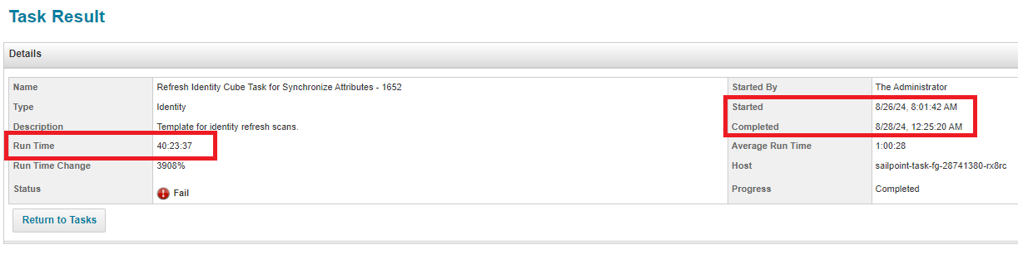
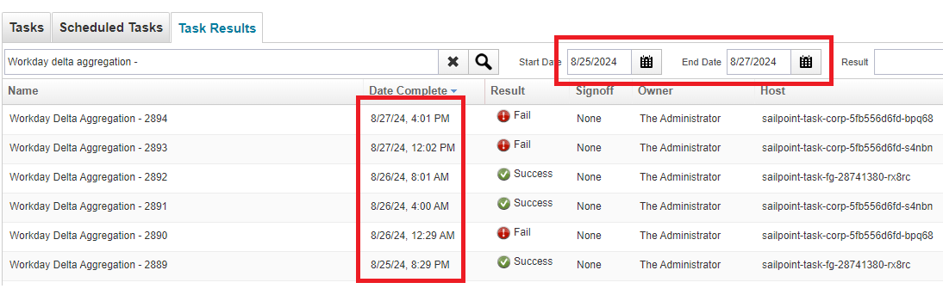
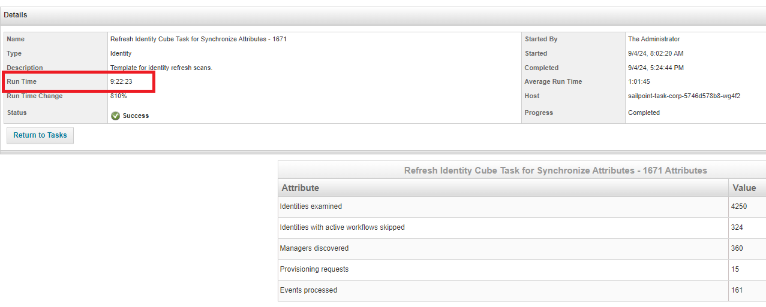
Appendix 1.1
Delay in refresh of terminated users in SailPoint due to the delay of Workday Delta Aggregation and Sequential Refresh Task. Example below
1. Between 26th to 27th Aug, Workday Delta Aggregation task got executed only 3 times and failed to execute 2 times, because the latest refresh task took almost 40 hours to complete which eventually got finished on 28th Aug.
2. Another example on 4th Sept, where refresh sequential task took 9+ hours time to process 4k records which created a delay for the latest users to be refreshed in SailPoint.

Slide 12
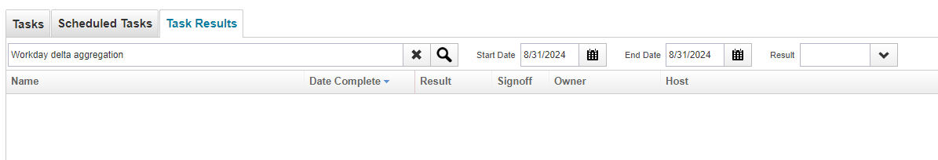
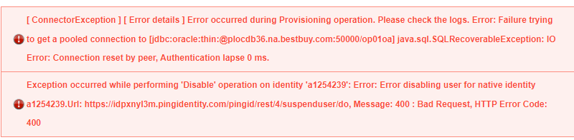
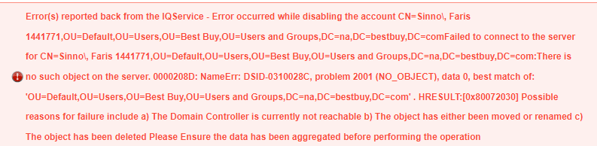
Appendix 1.2
Past terminated users are not included in Workday daily termination report. Workday create separate ticket for SailPoint to take care such issues. Sample incident# INC11855361, INC1185362 where user#A3081468 and A3071545 terminated more than 60 days in past
Delay in auto launching of Workday Delta Aggregation Task – Restart of servers resolve this issue. Example
On 31st Aug, Workday delta sequential task didn’t run for single time because from 30th Aug evening, the servers were inactive, and no tasks were running at that time. Restarted the servers resolved the issue.
SailPoint Connector Exception while connecting target system during the rapid setup leaver task. Example, User not available in target while triggering the Leaver Event

Slide 13
Appendix 1.3
Past 6 month's data
Manual Activity | Discrepancy Type | Effort(hour) per Activity |  | last 6 Months count |  |  |  |  |  | Total Effor in last 6 month | Monthly aferage effort
Incident |  |  |  | Aug | July | June | May | Apr | Mar
 |  |  | Count | 22 | 21 | 18 | 12 | 22 | 23
 | Rehired | 2.5 | Total Effor per month | 55 | 52.5 | 45 | 30 | 55 | 57.5 | 295 | 49
 | Terminated | 1 |  | 22 | 21 | 18 | 12 | 22 | 23 | 118 | 20
Discrepancy Fix
 |  |  | Days | 20 | 20 | 20 | 20 | 20 | 20
 | Rehired | 2.5 | Total Effor per month | 50 | 50 | 50 | 50 | 50 | 50 | 300 | 50
 | Terminated | 1 |  | 20 | 20 | 20 | 20 | 20 | 20 | 120 | 20

Slide 14
Thank you!

Slide 15
 | Data discrepancy Issue Incident for August Month
Sample Example inc | Discrepancy Category | Week 1(1-3) | Week 2(4-10) | Week 3(11-17) | Week 4(18-24) | Week 5(25-31) | Total
INC11856655 | BoD Accounts with null job code |  | 1 |  |  |  | 1
INC11903823 | New Mexico users being created in SAP |  |  |  |  | 1 | 1
INC11858441 | Reevaluate Entitlements |  | 1 |  | 1 | 1 | 3
INC11853751 | Rehires/Terms Not Synced | 3 | 4 | 5 | 5 | 5 | 22
INC11860832 | Reprocess Breeze Accounts |  | 1 |  |  |  | 1
INC11828412 | User Data in OIG/AD Not Matching Workday(Manager,jobcode,location) | 3 | 4 | 5 | 5 | 5 | 22
INC11896388 | Remove Role from User |  |  |  | 1 |  | 1
 |  |  |  |  |  |  | 51

